Slide 1
LINEAR REGRESSION AND RANDOM FOREST
Presented
By
Manohar Nookala

Slide 2
Learning Objectives ______________________________________________________________________________________
Intuitions of linear regression algorithm
Variance
Covariance
Slope
Intercept
Error rate
Random Forest algorithm
Advantages
What is random forest
Parameter tuning

Slide 3
INTITUTION OF LINEAR REGRESSION ALGORITHM:
Algorithm: Algorithm is a system defined program. In our machine learning we search for regressor line or classifier.
Regression is a predicting modelling technique and predict the continuous values.
Classification is a machine learning technique. It learns from the data given to it. And it classify the unknown data from its learns.

Slide 4
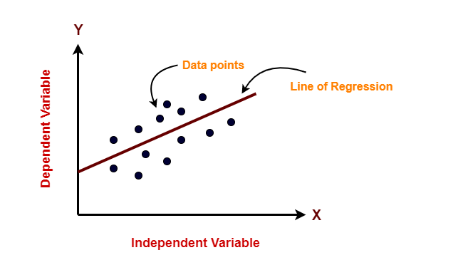
Graphical Representation of Data

Slide 5
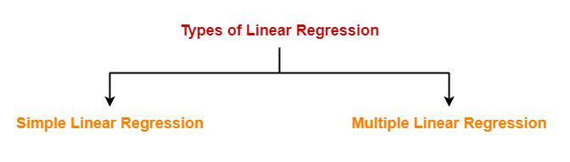
Types of Regressions Based on number of features in the dataset types of regressions came into the picture.

Slide 6
SIMPLE LINEAR REGRESSION
If I have a single dependent[Target] and independent features then i go through simple linear regression. Else I go through multiple linear regression
Y=m*X+c
Where,
Y= Dependent variable[target feature]
X=Independent variable
m=Slope
c=Intercept

Slide 7
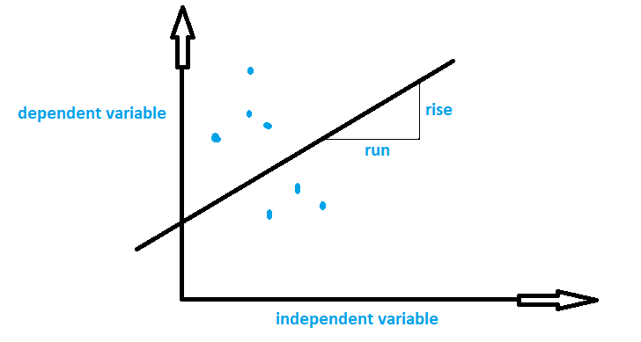
Slope slope is indicated with letter “m”. Slope is the ratio of rise and run.

Slide 8
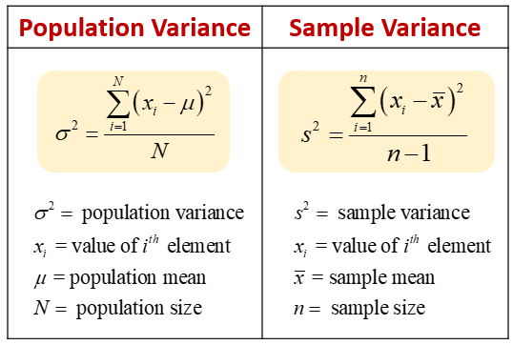
slope
Mathematically, slope is calculated with variance and covariance.
Variance: variance is describe the distribution of values of a feature.

Slide 9
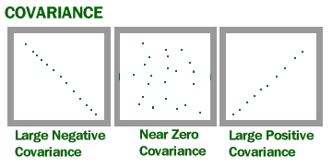
Covariance or correlation
Covariance gives you the relation between two variables. How they are correlated like is negative or positive or neutral.

Slide 10
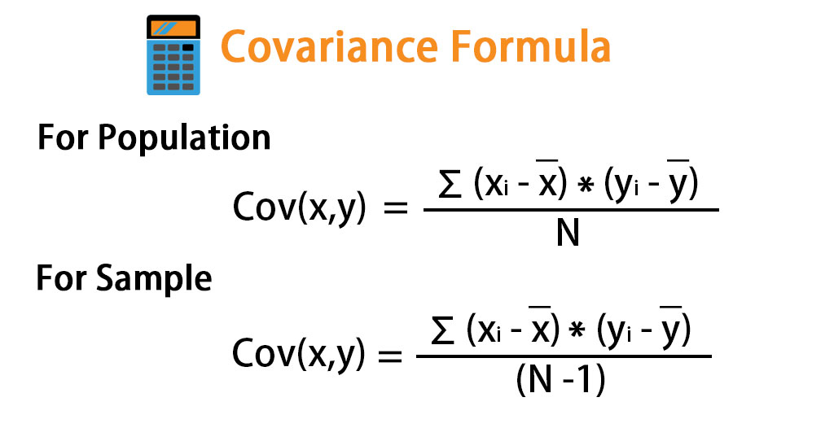
covariance
Covariance is calculated with below formula

Slide 11
Formula for slope and intercept
Slope[m]=(covariance/variance)
Intercept is the interaction between the y-axis and regressor line.
Intercept=mean(y)-m*mean(x)

Slide 12
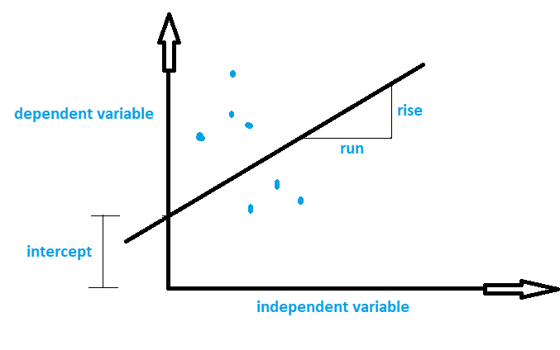
Representation of slope and intercept Intercept is the height between interacted point to the x-axis.

Slide 13
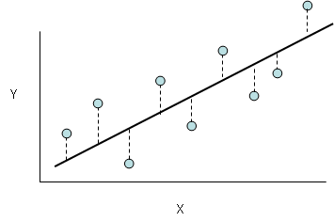
Error rate or residual
Error rate can be calculated mainly in below ways
General formula for error
Error=Actual value- predicted value
Least Squared Error
Mean Squared Error
Sum of Squared Error

Slide 14
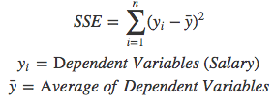
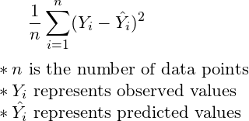
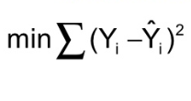
Formulas for error rate SSE MSE LSE

Slide 15
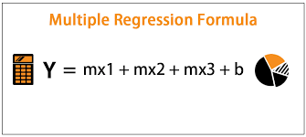
MULTIPLE LINEAR REGRESSION if the features are increased then slopes will also will increase. It is same as simple linear regression.

Slide 16

RANDOM FOREST
What is random forest algorithm ??
Random forest is an ensemble algorithm. It uses the number of decision trees to predict the data effectively.

Slide 17
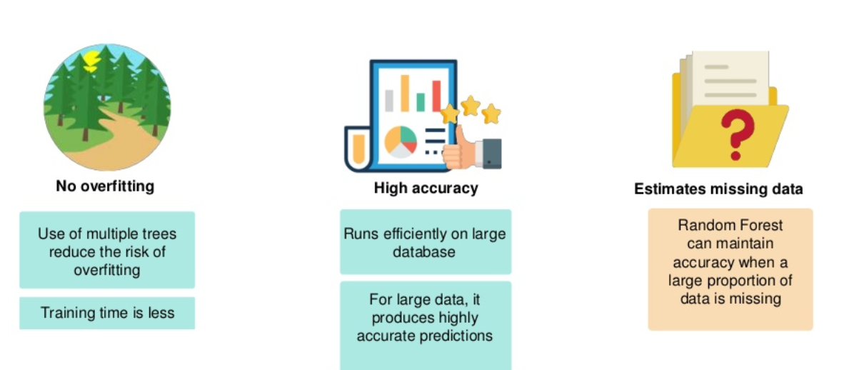
Advantages of Random Forest

Slide 18
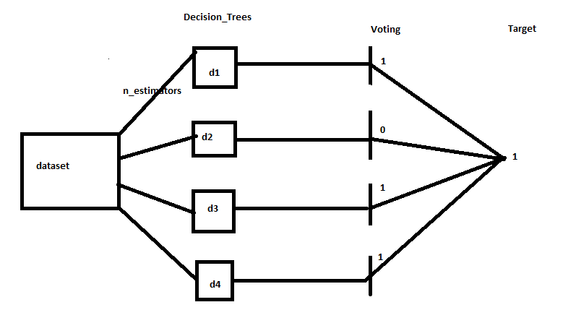
INTITUTION DIAGRAM OF RANDOM FOREST

Slide 19
Random forest Parameter Tuning
n_estimator
criterion
max_features
min_sample_leaf
random_state

Slide 20
n_estimators: it select number of decision trees from entire dataset.
For example if the dataset has “N” number of rows. Then if I want 5 decision trees then it calculate like N/5.
random_state:random_state is the seed used by the random number generator.
max_features:These are the maximum number of features Random Forest is allowed to try in individual tree. We can present it in Auto/None or sqrt(num_features) or percentage(0.2).

Slide 21
Min_sample_leaf: Leaf is the end node. A smaller leaf makes the model more prone to capturing noise in train data.
Criterion [gini or entropy]: It gives you the uncertainty in data.

Slide 22
THANK YOU

